Slide 1
NGO COMMUNICATING
Ivana Bursíková

Slide 2
CONTENT
Communication
Why?
What? – criteria
Who? – target groups, criteria
How? – media, working with journalists, organising public debates

Slide 3
COMMUNICATION
Communication is a mutual understanding between two or more people.

Slide 4
WHY?

Slide 5
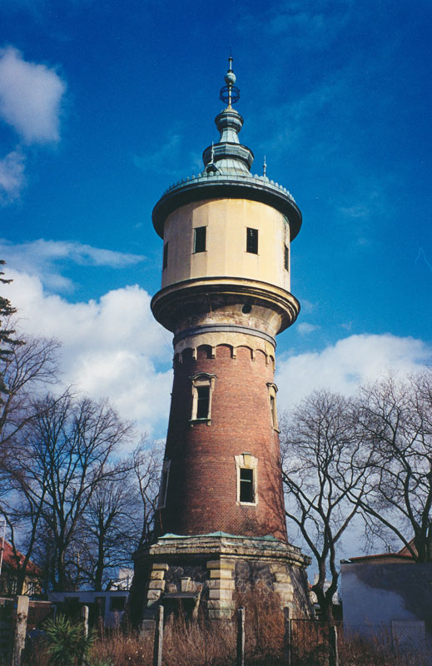
Ivory Tower
designates a world or atmosphere where intellectuals engage in pursuits that are disconnected from the practical concerns of everyday life.

Slide 6
COMMUNICATION
What do we want to say?
Who do we want to say it to?
How do we want to say it ?

Slide 7
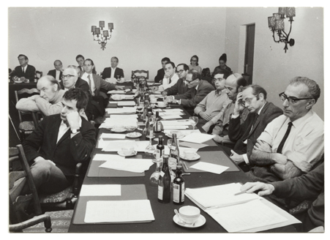
WHAT?

Slide 8
WHAT - Criteria
policy paper, policy brief, memorandum
Is our message intelligible? Could the general public understand it?
Is it constructed in an interesting way?
Is it short enough to be memorable (KISS)?
Does it contain enough information?
Is the message strong enough to make people react?

Slide 9
WHO?

Slide 10
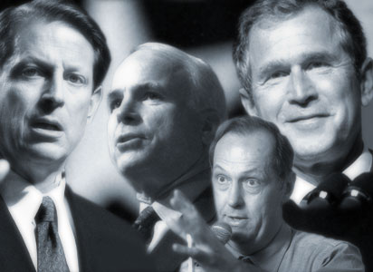
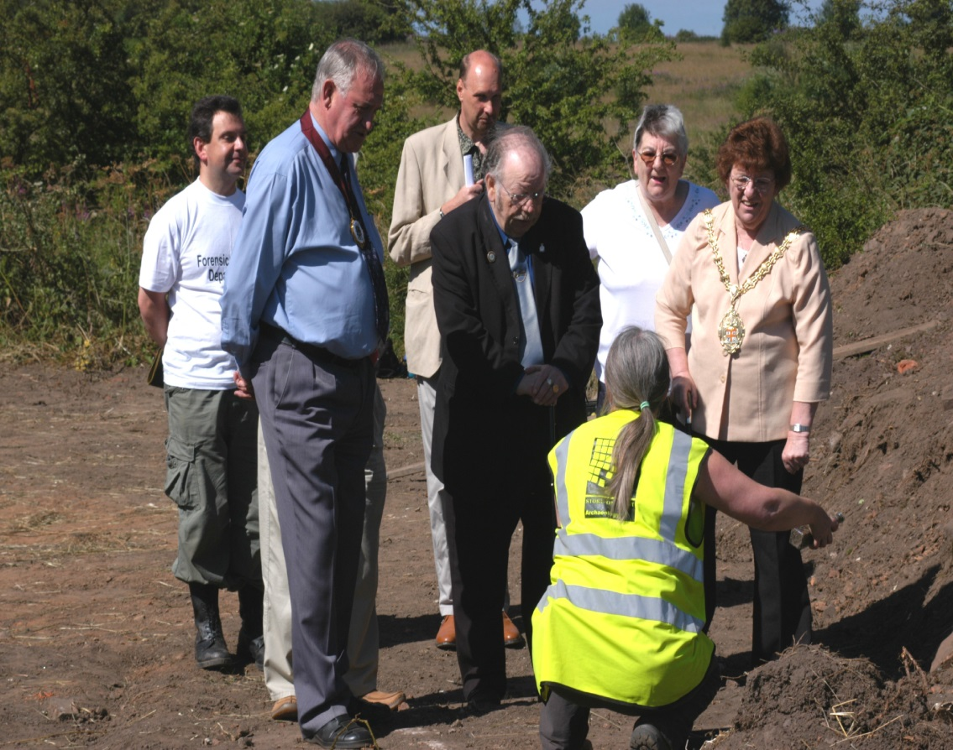
WHO
Generally:
politicians
civil servants
academics
businesses
citizens (organised, not organised)
Different levels:
Local, regional
National
European
Supranational (global)

Slide 11
Scope of operation of various stakeholders) in different public spaces…: | …and at various levels:
 | European level | National level | Regional/local level | Supranational level
Politico-administrative | European Parliament, European Commission, Council of Europe, European political parties, European NGOs | National Parliament, national governments, political parties, NGO, organizations of the commercial sector | Regional governments, regional NGOs | UN, other international organizations, global NGOs
Public services delivery | European Parliament, European Commission, European public sector organizations, citizens’ and client organizations at the European level | National parliaments, national governments, national public sector organizations, citizens’ and client’ organizations at the national level | Regional governments, citizens’ and client organizations working at the regional level
Academic | European scientific journals and events | Scientific journals, books, and events in national languages |  | International scientific journals, books, and events
Mediated public space | European media | National media | Regional (local) media | Global media

Slide 12
WHO - Criteria
Are the target groups
well-defined?
Do we cover all the target
groups? Is our list too limited?
Are we missing any groups that should or could be informed?
Which target groups are more important to us?

Slide 13
HOW?

Slide 14
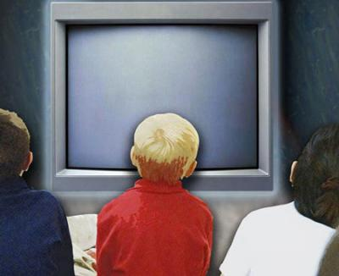
HOW - Media
Mass media
Television
Cinema (documentary)
Radio
Public debates
Newspapers
Magazines
Billboards
Internet
Specific media
Billboards
Means of transport
Shop windows
Packaging
Promotional objects
Mailing
Hot media
Television
Radio
Public debates
Cinema
Telephone
Cold media
Newspapers
Magazines
Billboards
Means of transport
Shop windows
Packaging
Handouts
Promotional objects (bags, pencils, lighters etc.)

Slide 15
HOW - Media
Mass media:
Web-based publishing
Newspapers
Radio
Newspaper and magazine advertisements
Television
Weekly magazines (programs and news spots)
Commercial journals
Cinema
Alternative media:
Printed/written media
Annual reports
Newsletters
Policy briefs
Information kits
Specialized reviews
Banners
Local publications
Pamphlets and brochures
Teaching materials
Letters
Audio-visual media:
Advertising panels
Posters
Documentary films
Public announcements
Exhibitions
Photographic exhibitions
Video and slide presentations
Interactive media:
Presentations
Participation in existing events
Press conferences
Round tables
Expert conferences
Public debates
Public meetings
Prizes and recognition awards
Symposia in universities
Telephone
Demonstrations
Special thematic days
Competitions
Face-to-face
Street theatre

Slide 16
Ways of communicating with the media
press releases
press conferences
radio interviews
television interviews
online presence at discussion boards

Slide 17
Types of press releases
PR informing about an event
PR reacting to an event
PR press release accompanying a publication/premiere/launch (research, book, film, etc.)

Slide 18
How to write up a good press release
Headline – the most important; short, poignant, with a verb. A headline encapsulates the whole content and message of the press release.
Header – name of the organisation, logo, contact details (address, telephone, email, website).
Date/location – an indication of date and location of its publication (at the beginning of the first paragraph).

Slide 19
Body copy
Five W - What? Who? When? Where? and Why? + How?
First paragraph – answers to all the above questions in a nutshell – outlining the key messages.
Reverse pyramid – edited starting from the end with message integrity as the criterion.
Direct speech –the subsequent paragraphs
Contact – the end of the PR or the header.
Notes, attachments – numbered references, footnotes, links to the website
Brief profile of you –under the contact details or a note
Length of the PR – ideally 5 paragaphs, 1 A4 page

Slide 20
Key rules for distribution of press releases:
PR must be sent from a known address
Send to - your own address
BCC - the mailing list of the media
Subject - brief and clear terms
The body of the email - the whole PR or its headline and the first paragraph
First publish the press release on our own website, then send to the media (an email and a link).
The PR in a text format may be attached.
Images – publish the gallery online, link to it in the PR

Slide 21
What makes an interesting press release?
Emotion – people like to read about emotions
A clear and easy-to-comprehend information – not too technical
Current – the information is hot news!
Is different from others – catches the eye
Carries a promise of a follow-up – there is more to be written about, there is a development

