Slide 1
Cooperation between the government and NGOs
Ivana Bursíková - Agora Central Europe

Slide 2
Content - about Government Council for Non-governmental Non-profit Organizations - cooperation with NGOS in drafting strategic documents - role of NGO in forreign policy - conclusions

Slide 3
Government Council for Non-governmental Non-profit Organizations (GCNNO)
Representatives of state administration and NGOs
Accumulates, discusses and submits NGO-related materials to the government
Creation of a positive environment for their existence and work
Especially state subsidy policy
Legislative and political measures
Cooperation between ministries, other agencies and local
self-governance authorities related to NGO support
Monitors, analyzes and publishes information about NGO situation in the EU
Availability and disclosure of information related to NGOs and relevant measures

Slide 4
Cooperation between state administration and NGOs on drafting strategic documents
Relations depend on the degree to which each particular ministry needs NGO sector or whether it must communicate with it - significant differences
Cooperation is much better at levels lower than central state administration (e.g. at the regional level)
Factors influencing the degree of involvement: proximity of subject matter and interests to NGO priorities (expertise), the degree of openness of each particular ministry towards NGOs, NGO’s interest in getting involved
Two approaches to NGOs across ministries: broad consultations, involvement, especially within review process compared to limited openness, very selective choice of partners, involvement only as means of preventing conflict of interest at final approval of the document

Slide 5
NGO role in foreign policy
International Development Cooperation Council - Czech Forum for Development Cooperation (FoRS) representative as an associated member
FoRS representative has only consultation role with the right to submit proposals, recommendations and opinions
Czech Development Agency is the implementing agency of Czech development cooperation, mostly donor role (often NGO projects)
Very narrow cooperation; NGOs both implement the
projects and help CDA identify and formulate them

Slide 6
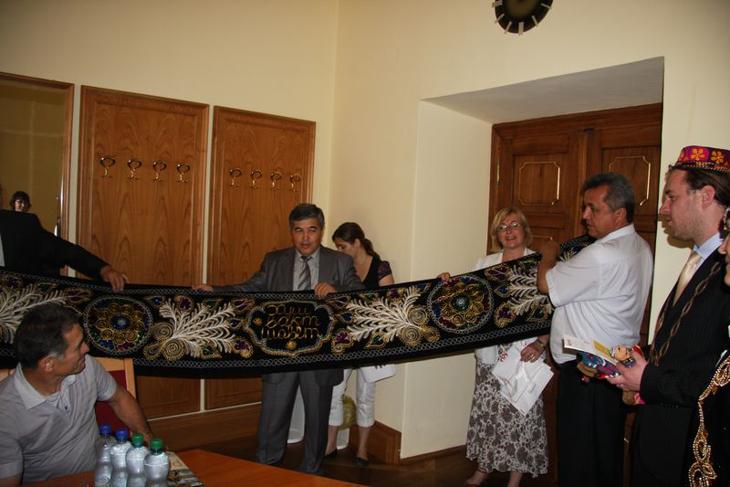
NGO role in foreign policy
Human Rights and Transition Policy Department of the Ministry of Foreign Affairs selects, manages and finances projects and activities aimed at promoting human rights and transformation
NGOs are generally in a reactive position in foreign policy; they do not have the ambition and
the desire to form it actively

Slide 7
Conclusion
At government level - Government Council for Non-governmental Non-profit organizations
The status of NGOs regarding state institutions and the level of cooperation differs significantly from ministry to ministry
Its degree depends, first of all, on conceptual documents of individual agencies, as well as on habit
Intense cooperation with the Ministry of the Environment, Ministry of the Interior, for example; however, the usual role of a ministry is that of a donor

Slide 8
Coalitions of NGOs
Influencing policy and public opinion
Examples:
Demas – forreign policy
Reconstruction of the state – laws
Women agains home violence – law
Zeleny kruh – ecology
EDUin – education
Towns without cars, Other city experience, CEE CN – public space

