Slide 1
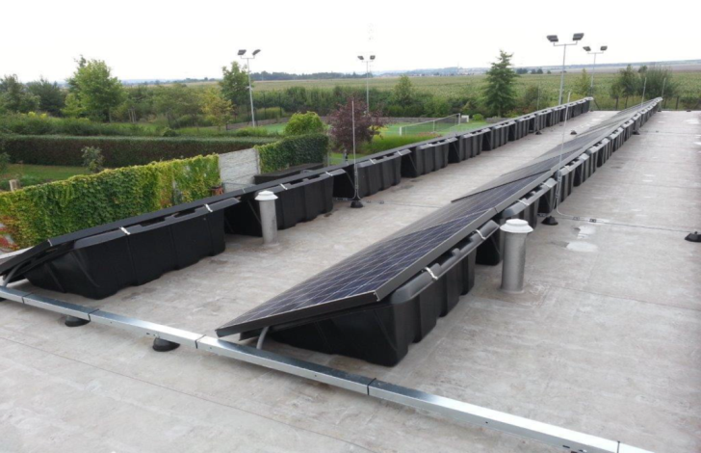
ENERGY TRAINING
Part 2 – Energy projects – best practice

Slide 2
Municipal Energy Plan (MEP)
EM
Analysis
Aims
ESF
Projects
Process
Project preparation
EPC
Indicators
PV
Refurbishment
Evaluation

Slide 3
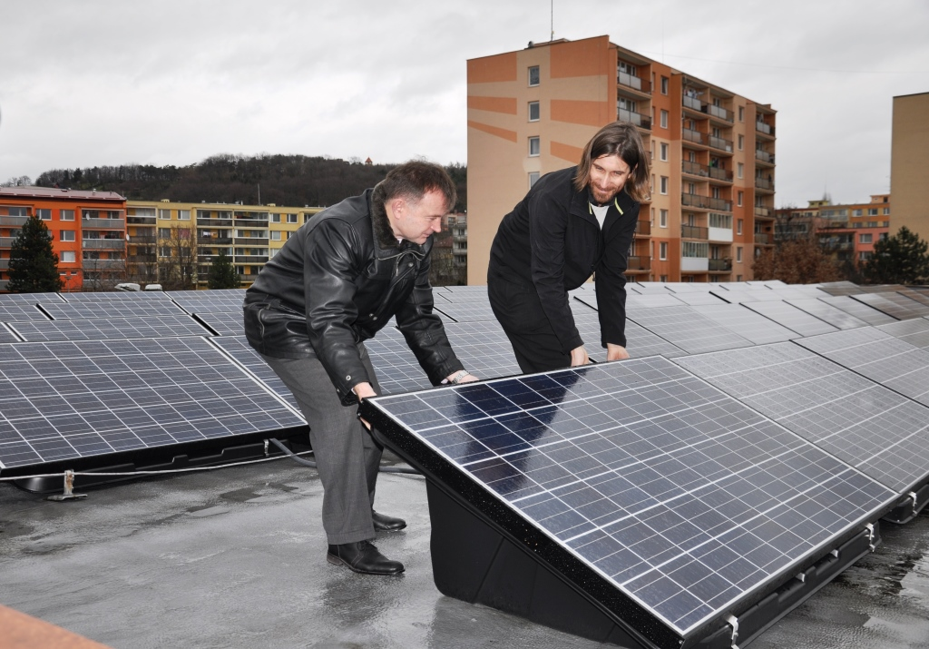
Projects
Is it enough?
Will it work?
If not, I will kick him out.

Slide 4
Projects – how to prepare?
Long term data – energy and technical state
EM; technical data – passport, public lighting
Expert reports
Energy reports; EPC - analysis
Project „basket“ and their evaluation
Sustainability impact
Action plan
Prioritization of projects
Project documentation and project
Real project operation
Real impacts after investment – EM

Slide 5
Energy Performance Contracting (EPC)
Correlation with strategy – Energy plan, Plan of renovation
Prepared EPC analysis – subsidy MIT
Suitable buildings and preliminary measures
Information for negotiation with City Council
After negotiation – study for contract for consultant tender (Tender no 1)
Negotiation with applicants – (Tender no 2)
External consultants
Precise information about technical state – definition of obligatory measures
Tender of service (savings and guarantee)
Contract signing, verification, realization
Evaluation – EM

Slide 6
Projects
Maximal usage in the building.
Works as proposed.
We need another one.

Slide 7
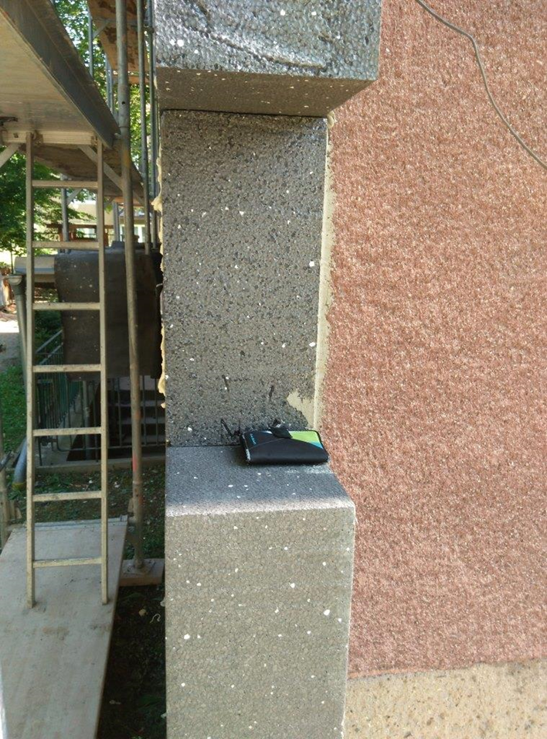
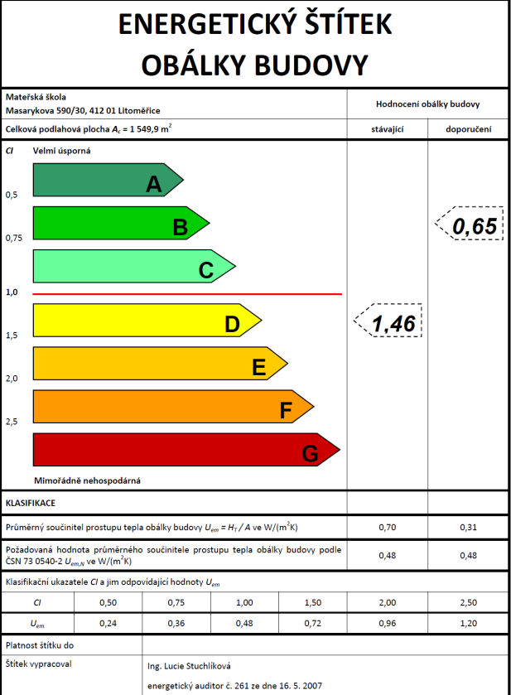
CoMPLEX REFURBISHMENT
Real heat consumption 25 kWh/(m².a) savings 85%
Proposed heat consumption 31 kWh/(m².a) savings 81%

Slide 8
PHOTOVOLTAICS
3 buildings (school, kindergarten)
80 kWp
Payback time 8-10 years, net benefits 150.000 EUR

Slide 9
ENERGY SAVING FUND (ESF) – WHY?
Different effort (motivation) of municipal organizations on ES
Realization of measures with no long-term evaluation of benefits
Preference of low cost investments
Lack of finances for pre-project analysis, energy audits, etc.
Money for energy bills going out of the region

Slide 10
BENEFITS OF ESF
Financial source for pre-project analysis
Higher value of municipal properties
Better comfort for users
Fulfilment of Municipal Energy Plan
Clear system – How to divide ES
Motivation of municipal organizations to decrease their energy consumption
Good operation of ES measures (recuperation, regulation of heating system, etc.)

Slide 11
Establishment of ESF
ESTABLISHMENT OF ESF
September 2013 – ESF- version No.1
Discussion with Financial Department and City Council
October 2013 – separate account for energy
November 2013 – ESF- version No.2
December 2013 – ESF methodology approved by the City Council – declaration 687/26/2013
April 2014 – Financial Committee approved financial allocation of savings for the year 2014
Yearly evaluation of energy savings – reports for Financial Committee and City Council

Slide 12
ESF Allocation
I. Energy savings of all measures
Year 2016
16 thous. EUR ESF
14 thous. EUR municipal organization
2.5 thous. EUR Commission Fund
IV. 35 % allocation to the municipal budget
II. Cost for energy saving measures
V. 30% allocation to the Energy Saving Fund
VI. 30% allocation to the municipal organizations
III. Net energy savings
VII. 5% Commission Fund – allocation approved by mayor

Slide 13
THANK YOU FOR YOUR COOPERATION
Jaroslav Klusák
City of Litoměřice
Energy manager jaroslav.klusak@litomerice.cz; mob. +420 773 165 574

