Slide 1

Rapid re-housing Brno
case study of the Czech Housing First approach

Slide 2
Housing first approach
Families who have been stabilized in housing will reunify with their institutionalized children, family well-being and social inclusion will improve, and at the same time public expenditures for those families will decrease.

Slide 3
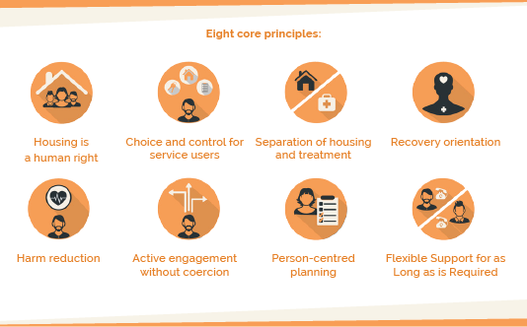
Main principles of Housing first
Notes:
1. Housing First emphasizes the right that homeless people have to housing. Housing is provided first, rather than last, without any expectation that a homeless person has to behave in certain ways, comply with treatment, or be abstinent from drugs or alcohol, before they are given a home. Housing First does not expect homeless people to earn their right to housing, or earn a right to remain in housing.
2. People using the service should be listened to and their opinions should be respected. Someone using Housing First is able to exercise real choices about how they live their lives and the kinds of support that they receive.
3. Housing First ensures the human right to housing is not compromised by requiring service users to engage with treatment either to access housing, or to remain in housing. Housing is therefore separate from treatment.
4. A service with a recovery orientation focuses on the overall well-being of an individual. This includes their physical and mental health, their level of social support (from a partner, family or friends) and their level of social integration, i.e. being part of a community and taking an active part in society. Promoting recovery can include enabling access to education or helping someone find a rewarding leisure activity. Following a recovery orientation is something far wider and more ambitious than just regulating drug or alcohol use, or supporting engagement with treatment. It
5. Harm reduction is based on the idea that ending problematic drug and alcohol use can be a complex process and that services requiring abstinence, or detoxification, do not work well for many homeless people.
6. Within the harm reduction and recovery orientation of Housing First, the emphasis is always on positively trying to get people using Housing First to engage with the help they need. Housing First service users are also asked to look constructively at any aspects of their behaviour that might threaten their exit from homelessness or their health, well-being and quality of life.
7. Housing First services use person-centred planning, which essentially involves organising support and treatment around an individual and their needs. This focus reflects the emphasis on choice and control for service users.
8. Support intensity can rise and fall with individual need, so that Housing First can respond positively when someone needs more, or less, help on a day-to-day basis.

Slide 4
Rapid re-housing Brno
The project provides a municipal flat and intensive housing first case management for 50 families who were previously living in private hostels, shelters or other forms of homelessness (ETHOS).
Notes:
The City of Brno (pop 400 000), which owns and controls access to 29 000 flats, approved a strategy to end family homelessness: to make it rare, short and non-recurring.
Since 2016 various traditional and experimental approaches have been tested for outcomes. Among them, the housing first approach seemed very promising, so 50 municipal flats were dedicated to showcase housing first in Brno and measure its impact through randomized control trial.

Slide 5
Who is inside?
421 families living in private hostels, shelters or other forms of homelessness.
Experiencing a first housing crisis has been shown to be a path to long-term homelessness for two thirds of families.
92% of homeless families experienced long-term (more than six months) homelessness in their life for period of 8 years.
Two thirds of these families are Roma.

Slide 6
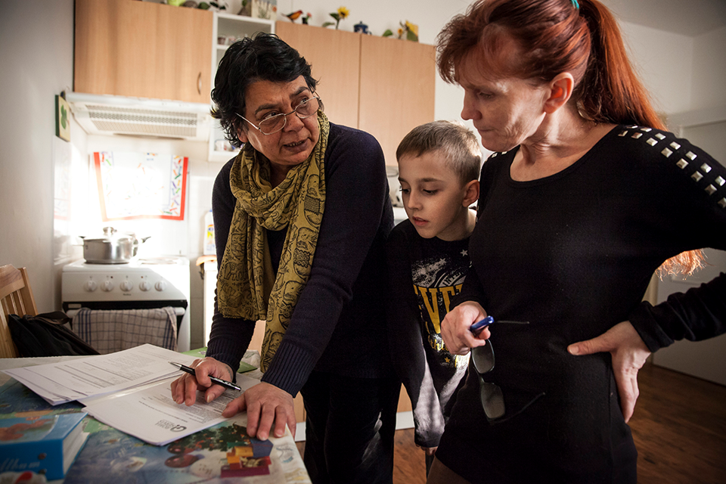
Who is behind?
The service provider is local pro-Roma NGO IQ Roma Servis.
City of Brno
The University of Ostrava

Slide 7
What are the expected outcome?
Families will have higher family reunification rate in household.
School attendance of children will improve in short term and school attainments will improve in medium-term.
Both physical and psychological health of the families will improve.
Family budgets will be more predictable, and overall finance management will improve in the treatment group.
The quality of life will improve with treatment families.
Anomia will decrease with treatment families.
Average public expenditures towards the treatment families will be lower than those of the control group families.
Notes:
Ad 1. - 41% of homeless families in Brno live separated from some nuclear family member, in many cases due to lack of housing. Children are placed in institutional care and foster care or juvenile justice, 23% of the parents cannot live together in a household. Allocation of housing and case management is expected to change this situation.
Ad 2. - Children in homeless families have poor school attendance and subsequently poor grades due to high rates of illness, cost of transport, lack of resources and other reasons connected to exclusion from housing.
Ad 3. - 39% of surveyed mothers have very high rates of psychological distress (score in Kessler K-6 scale that indicates severe mental illness) which makes it difficult for them to focus on nurturing. After moving in, the psychological distress should decrease, as well as prevalence of diseases connected to inadequate housing - asthma, chronic cough, hepatitis.
Ad 4. - Only 20% of homeless families are left with subsistence money at the end of the month, 35% lack subsistence money for one week each month, 28% lack money between 1-2 weeks each month.

Slide 8
What is the result after six month?
The first families moved in in September 2016 and by May 2017 all 50 families were housed. We aimed 80% housing retention rate after one year, currently we are at 96% (04/2018)
Notes:
Other results are:
Families will have higher family reunification rate in household – Neprokázal se dopad na institucionalizaci dětí, ani na návrat dětí z ústavní péče.
School attendance of children will improve in short term and school attainments will improve in medium-term. Data o školní docházce a školních výsledcích dětí budou sbírána až pro analýzu po 12 měsících.
Both physical and psychological health of the families will improve - zlepšil zdravotní stav rodičů i dětí a výrazně se snížila četnost využívání antibiotik, o 1,26 léčení na domácnost během půlroku. Zlepšil se také spánek dospělých a dětí a celková životní spokojenost
Family budgets will be more predictable, and overall finance management will improve in the treatment group. - Neprokázal se dopad na ekonomickou stabilitu rodin, a to ani v částce, která rodině chybí každý měsíc na pokrytí základních potřeb, ani v reziduálním příjmu. Nezlepšila se kontrola rodin nad dluhy, ani výskyt krátkodobých půjček, méně rodin využilo zastavárnu
The quality of life will improve with treatment families. - výsledky ukázaly zvýšení stability a kvality bydlení, Zlepšilo se i subjektivně vnímané bezpečí
Anomia will decrease with treatment families. - Snížila se anomie a zlepšila se víra v poctivost druhých
Average public expenditures towards the treatment families will be lower than those of the control group families. - 25krát nemusela vyjíždět sanitka a předešlo se 19 hospitalizacím

Slide 9
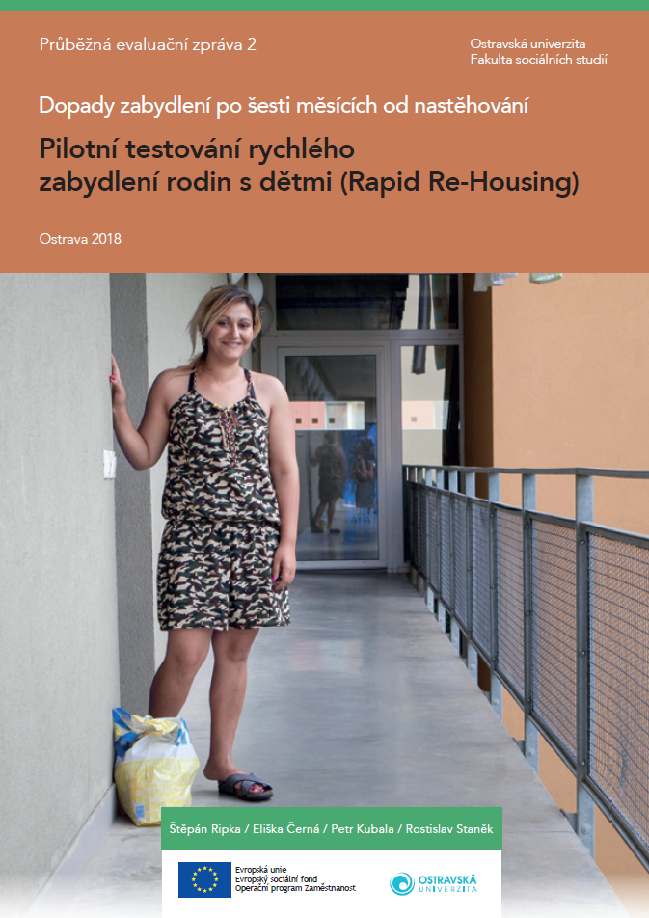
How do they measure it?
The impact of the project is measured by a Randomized Control Trial, counterfactual design, which allows it to isolate outside factors by comparing the treatment and control group.

Slide 10
Time line of the experiment
04/2016
09/2016 – 06/2017
3 – 12/2017
05/2016
06/2016
07 – 01/2017
field research of homeless families in Brno
421 families registred
Stratified Random Sampling (150 families)
quantitative research (148 families)
Random stratified distribution
Questioning – evaluation after 6 monts

Slide 11
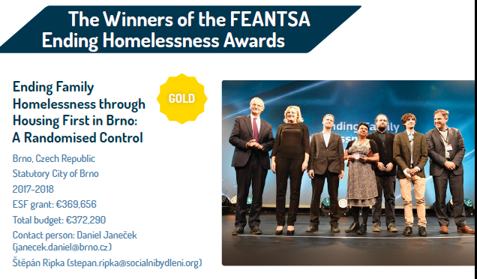
How the project is promoted?
Local and broadcasting media.
Support of Ministry od Work and Labor of the Czech Republic
Winner of the european award in Social inovation such as:
  SozialMarie
  FEANTSA ending homeless
Own networks

Slide 12
Rapid re-housing as a part of EBP process
On the national level, a Strategy to fight social exclusion was passed by the Czech government in 2016, which sets as one of its goals to move 6 000 families from hostels to standard housing by the end of 2020. Results from the RCT in Brno will be promoted, so that the strategy becomes a feasible plan. This would end family homelessness in hostels in the Czech Republic.
Housing first become one of the measures of the prepared Strategy of social housing of the Czech republic till 2025.
Randomized Control Trial and the approach of Rapid re-housing is supported as many other innovations from t of the social innovation program runn by ministry of work and Labour.

