Slide 1
Evaluation and ROMA methodology

Slide 2
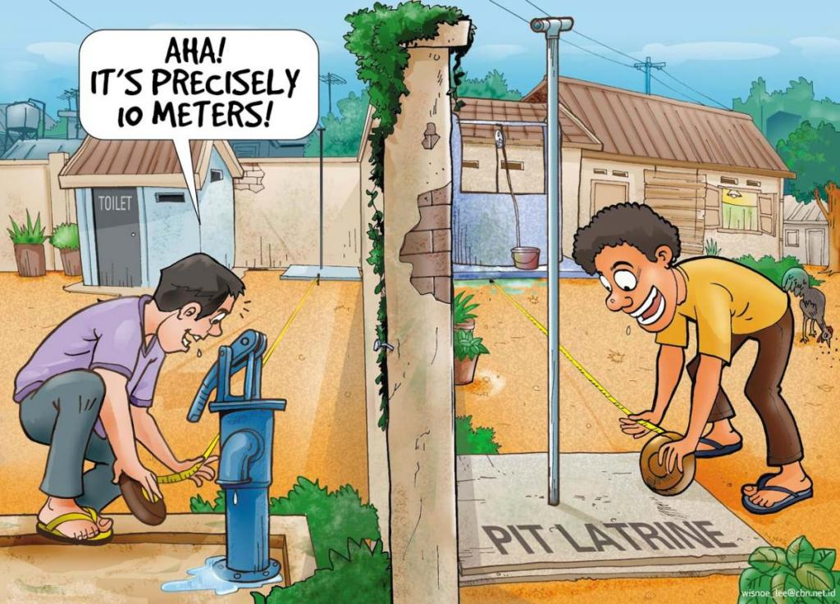
Why we need it?
Excurssion to the evaluation theory

Slide 3
What to evaluate?
Outputs
Outcomes
Impacts
Process
Inputs
All necessary resources used
Outcome
result of the activities
Impact
Longterm consequence of the outcome(s)
activities
Output
Specific work/operations done
Imediate product(s) of the activities

Slide 4
Exercise
Destinguish outputs/outcomes and results of the case study from Brno

Slide 5
Types of evaluation
Process evaluation
Outcomes evaluation
Program´s impact evaluation
Prospective research study
Formative assessment
Sumative assement

Slide 6
What type of evaluation would you use for your networks´activities? Why?

Slide 7
How to evaluate – design and methods
Design | Methods | How the conclusion is done
Experimental | Randomised control trials quasi experiments Experiments | There is direct causality between the activity and changes in the sample. Control sample shows no changes → contrafactual
Statistical | Statistical modeling Longterm studies Economerty | There is some correalition between the cause and effect or variables. We search for the causes of the efect.
Theory based | Theory of change, process tracking Inputs analyssis Impact analysis | There is chain of factors that cause on the effect.
Case study | Etnographical Grounded theory Simulation and network analysis | Multiple causality. Comparisson of the causes between the cases.
Participatory | Participatory assesment, learning by doing | Effect is confirmed by the participants acceptance.

Slide 8
What is ROMA
R – RAPID (research and policy in Development programme)
is one of many teams at the Overseas Development Institute (independent, global think tank, working for a sustainable and peaceful world in which every person thrives)
O – outcome
M – mapping
Outcome Maping was developed by the International Development Research Centre (IDRC) as a way of planning international development work and measuring its results.
The focus is on changes in behaviour, relationships, actions and activities in the people, groups and organizations it works with directly.
set of tools or guidance that steers project or programme teams through an iterative process to identify their desired change and to work collaboratively to bring it about.
A – approach

Slide 9
Rationale
Why ROMA?
once equipped with :
a set of simple steps to formulate and implement a plan,
sufficient skills and appropriate tools.
For these seeking to:
effect change could navigate in complex environment and
improve the likelihood of their evidence being listened to and incorporated into policy and practice.

Slide 10
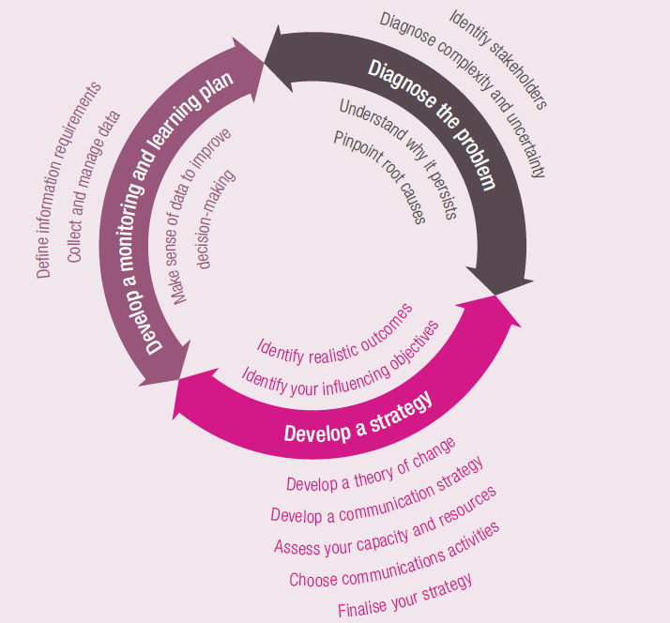
ROMA Approach

