Slide 1
Participatory budgeting in the Czech Republic - lessons learnt
by
Vojtěch Černý

Slide 3
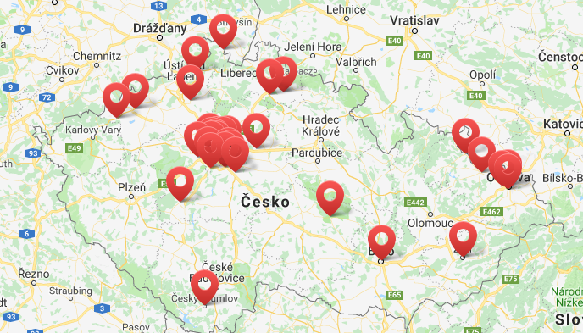
Municipalities using PB

Slide 6
Example of PB – City district Prague 10
106 th. inhabitants
2015 – 2016 1st pilot test
185 000 EUR per year
50,5 mil EUR – total expenditures of the municipality

Slide 7
Rules and principles
Prepared by the working group - in house
Agreed by the entire assembly
Main features:
Amount
What can be suggested: public spaces, municipal property
Who can suggest the project: citizen over 18
How are the proposal sugested: formal procedure
Decission: on-line form

Slide 8
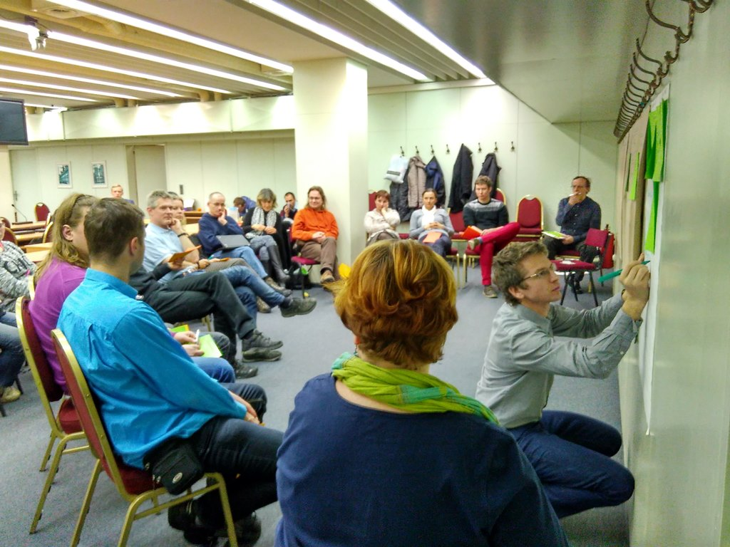
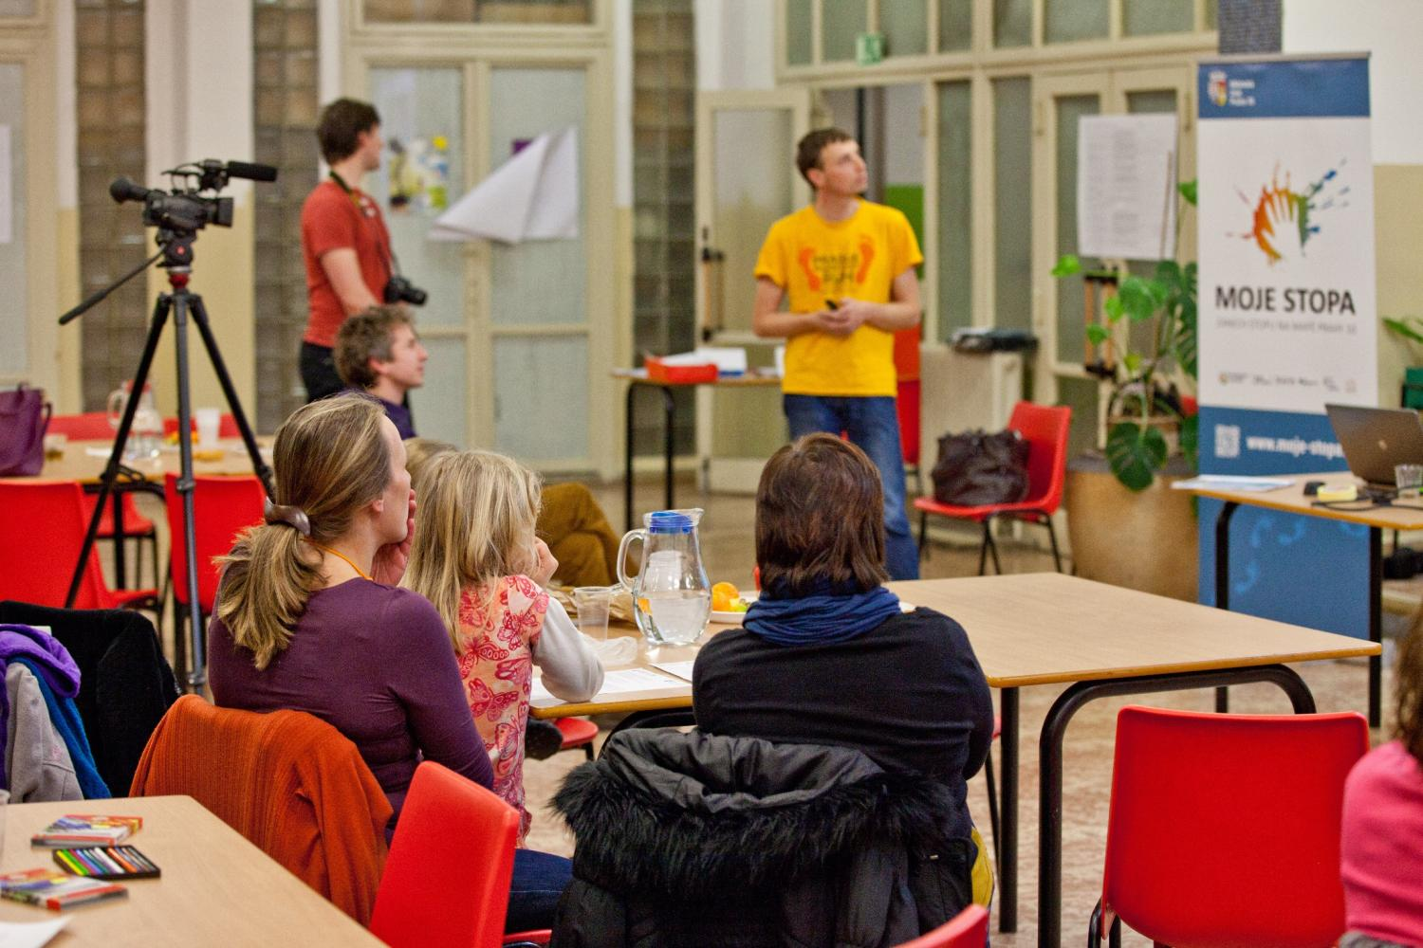
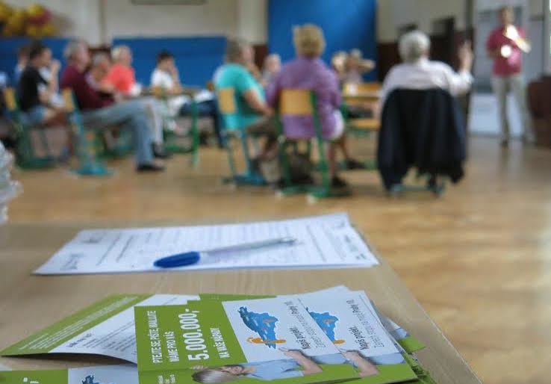
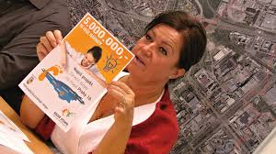
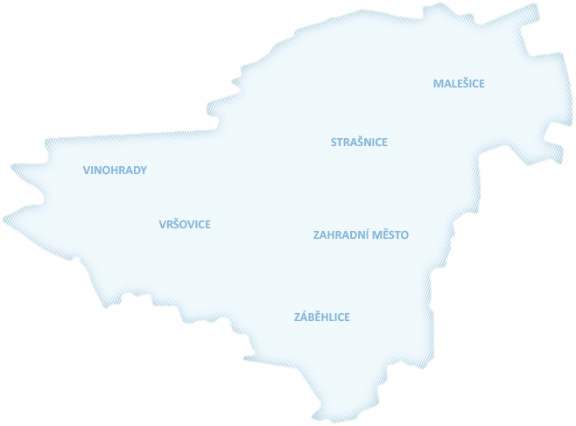
Time line of PB proces
June
Decission of the municipal assembly
July - September
information campaign
March - April
Evaluation, preparation of the next round
September - November
Call for proposals
February
Electronic voting
January
Presentation and discussion on proposals
December – January
Feasibility analysis

Slide 9
Results
10 public meetings (over 300 participants)
50 project proposals (approx. 0.8 mil. EUR)
33 of approved proposals (approx. 0.7 mil EUR)
12 proposals not feasible
2 proposals canceled by author
5 proposals merged into 2 new
5024 participants in on-line voting:
Approx. 4,6% local inhabitants
4 votes positive 2 votes negative

Slide 10
Lessons learnt
Only one model in the country.
Deliberation is transforming into direct decission making.
Underestimated running cost of the procedure (mostly in bigger municipalities).
Local hereos needed.

Slide 11
Thank you for your attention
Vojtěch Černý,
vojtech.cerny@agora-ce.cz
www.participativni-rozpocet.cz facebook.com/participativnirozpocet
Agora Central Europe Petra Rezka 12 140 00 Praha 4
www.agora-ce.cz

